Slide 1
Software Design for Cloud 2
Python Programming
Lecture 9
Recursion

Slide 2
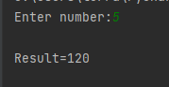
Recursion – first Program
Factorial 5! = 5*4*3*2*1 5! = 5 * 4! # Reduce towards Base
Factorial 0! = 1 0! = 1 # Base
factorial(5) = 5 * + factorial(4)
factorial(0) = 1
def factorial(number):
if number==0:
return 1
else:
return number * factorial(number-1)

Slide 3
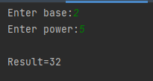
Exercise 91
Power(2,5) = 2*2*2*2*2 2⁵= 2 * 2⁴
Power(2,0) = 1 2⁰= 1
power(2,5) = 2 * + power(2,4)
power(2,0) = 1

Slide 4
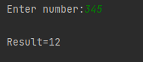
Recursion
Method calls itself
addDigits(3452) = 2 + addDigits(345)
addDigits(3) = 3
def addDigits(number):
if number<10:
return number
else:
last = number%10
rest = int(number/10)
return last + addDigits(rest)

Slide 5
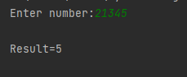
Ex92 (Ex92_skel.py) Must Use recursion
countDigits(3452) = 1 + countDigits(345)
countDigits(3) = 1

Slide 6
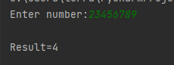
Ex93 (Ex93_skel.py) Must Use recursion
countEven(34526) = 1 + countEven(3452)
countEven(34527) = 0 + countEven(3452)
countEven(3) = 0
countEven(4) = 1

Slide 7
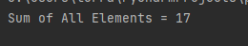
Recursion with Lists
addList[]=0
addList[2,5,2,8]= 2 + addList[5,2,8]
def main():
list1 = [2, 5, 2, 8]
result = addList(list1)
print('Sum of All Elements = {0}'.format(result))
def addList(listp):
if len(listp)==0:
return 0
else:
# remove first
first=listp.pop(0)
return first + addList(listp)
main()

Slide 8
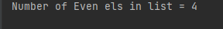
Ex94_ Complete method countEven Ex94_skel.py
def main():
list1 = [2, 5, 2, 8, 7, 3, 2, 5]
result = countEven(list1)
print('Number of Even els in list = {0}'.format(result))
def countEven(listp):
return 0
main()
countEven[] = 0
countEven[2,5,6,1] = 1 + countEven[5,6,1]
countEven[3,5,6,1] = 0 + countEven[5,6,1]
If (num%2==0): # to check if a number is Even

Slide 9
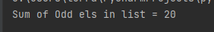
Ex95_ Complete method addOdd Ex95_skel.py
def main():
list1 = [2, 5, 2, 8, 7, 3, 2, 5]
result = addOdd(list1)
print(‘Sum of Odd els in list = {0}'.format(result))
def addOdd(listp):
return 0
main()
addOdd[2, 5, 2, 8, 7, 3, 2, 5] = (5+7+3+5) = 20
addOdd[] = 0
addOdd[2,5,6,1] = 0 + addOdd[5,6,1]
addOdd[3,5,6,1] = 3 + addOdd[5,6,1]
If (num%2==1): # to check if a number is Odd

Slide 10
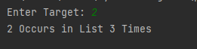
Ex96_ Complete method countTarget Ex96_skel.py
def main():
list1 = [2, 5, 2, 8, 7, 3, 2, 5]
target = int(input('Enter Target: '))
result = countTarget(list1, target)
print('{0} Occurs in List {1} Times'.format(target, result))
def countTarget(listp, tar):
return 0
main()
countTarget([2, 5, 2, 8, 7, 3, 2, 5], 2) = 3
countTarget([],2) = 0
countTarget([2,5,6,1],2) = 1 + countTarget([5,6,1],2)
countTarget([3,5,6,1],2) = 0 + countTarget([5,6,1],2)

Slide 11
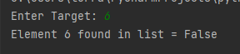

Search
def main():
list1 = [2, 5, 2, 8, 7, 3, 2, 5]
target = int(input('Enter Target: '))
result = searchTarget(list1, target)
print('{0} Found in List = {1} '.format(target, result))
def searchTarget(listp, tar):
if len(listp)==0:
return False
else:
first=listp.pop(0) # remove first
if (first==tar):
return True
else:
return searchTarget(listp,tar)
searchtTarget([],2) = False
searchTarget([2,5,6,1],2) = True
searchTarget([3,5,6,1],2) = searchTarget([5,6,1],2)

Slide 12
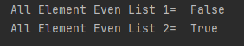
Ex97 Recursive Version of allEven if (el%2==0):
def main():
list1 = [2, 6, 2, 7, 8, 4, 2, 6]
result = allEven(list1)
print('All Element Even List 1= {0} '.format(result))
list2 = [2, 6, 2, 8, 8, 4, 2, 6]
result = allEven(list2)
print('All Element Even List 1= {0} '.format(result))
def allEven(listp):
allEven([2, 4,6]) = True allEven[]= True
allEven([2, 5,6]) = False allEven[2,3,4] = allEven[3,4]
allEven[5,3,40= False
# [2, 6, 2, 7, 8, 4, 2, 6]
# [2, 6, 2, 8, 8, 4, 2, 6]

Slide 13
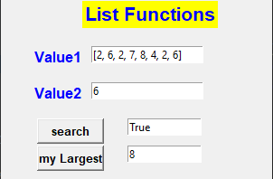
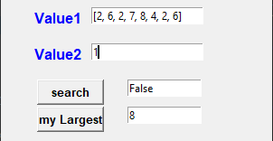
Ex98_ Complete method ‘myLargest’
def search(list,target):
if len(list) == 0:
return False
else:
first = list.pop(0) # remove first
if (first == target):
return True
else:
return search(list.copy(), target)
def myLargest(list):
# recursion to be completed
-------------------------------------------------------------------------------
myLargest([2, 5, 2, 8, 7, 3, 2, 5]) = 8
myLargest([ ]) = 0
myLargest([11, 5, 2, 8, 7, 3, 2, 5]) = 11
myLargest([4, 5, 2, 8, 7, 3, 2, 5]) = myLargest([ 5, 2, 8, 7, 3, 2, 5]) = 1 # assume only positive ints

